Slide 1
Key PharmNet and Medication Related Tables and Fields: Where does all the data go when I click Sign or Submit?
St. Jude Children’s Research Hospital
Don Baker, PharmD, MBA
Clinical Decision Support Officer
Dennis Huber
Director, Pharmacy and Supply Chain

Slide 2
Key PharmNet and Medication - Tables and Fields
PharmNet-Inpatient Formulary
  Review PhaDBProductMgr – Tables and Fields
  Query example
Power Orders – New Medication Order
  Review Power Orders – Tables and Fields
  Query example
Power Orders – Chart the Medication Task
  Review EMAR – Tables and Fields
  Query example
PhaMedMgr – Verification of Medication Order
  Review PhaMedMgr – Tables and Fields
  Query example

Slide 3
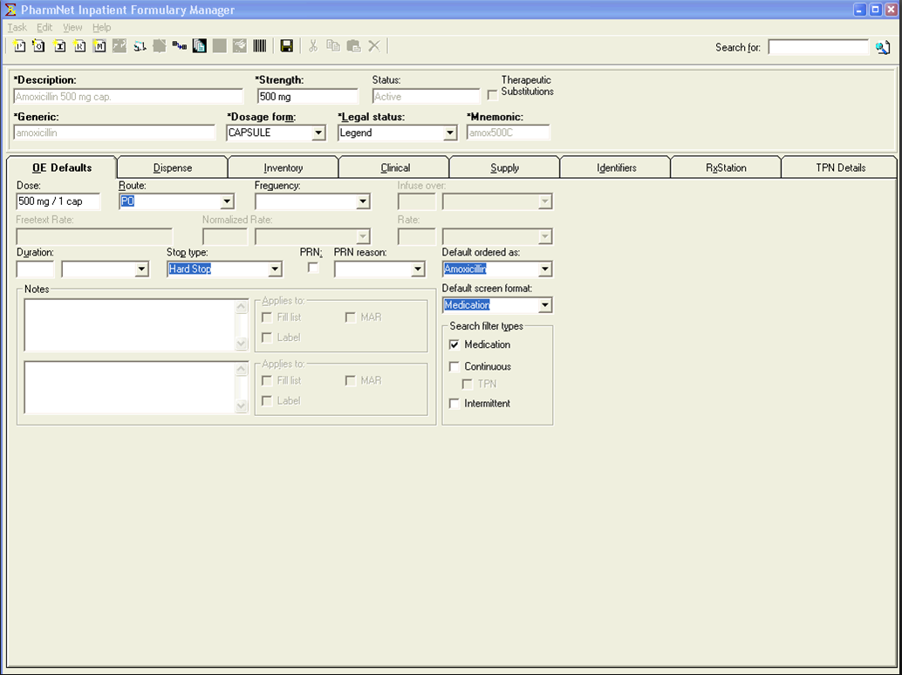
PhaDBProductMgr - Header

Slide 4
PhaDBProductMgr - Header
PhaDBProductMgr Field | Table | Field
Description | Med_identifier | Value
Strength | Medication_definition | Given_strength
Status | Med_def_flex | Active_ind
Therapeutic Substitutions | Rx_therap_sbsttn | From_item_id
Generic | Med_identifier | Value
Dosage Form | Medication_definition | Form_cd
Legal Status | Med_dispense | Legal_status_cd
Mnemonic | Med_identifier | Value

Slide 5
PhaDBProductMgr – OE Defaults Tab

Slide 6
PhaDBProductMgr – OE Defaults Tab (continued)
PhaDBProductMgr Field | Table | Field
Dose (Freetext) | Med_oe_defaults | Freetext_dose
Dose (Codified) | Med_oe_defaults | Strength, Strength_unit_cd, Volume, Volume_unit_cd
Route | Med_oe_defaults | Route_cd
Frequency | Med_oe_defaults | Frequency_cd
Infuse Over / Unit | Med_oe_defaults | Infuse_over, Infuse_over_cd
Freetext Rate | Med_oe_defaults | Freetext_rate_txt
Normalized Rate / Unit | Med_oe_defaults | Normalized_rate_nbr, Normalized_rate_unit_cd
Rate / Unit | Med_oe_defaults | Rate_nbr, Rate_unit_cd
Duration / Unit | Med_oe_defaults | Duration, Duration_uom_cd
Stop Type | Med_oe_defaults | Stop_type_cd
PRN / Reason | Med_oe_defaults | PRN_ind, PRN_reason_cd
Default Ordered As | Med_oe_defaults | Ord_as_synonym_id

Slide 7
PhaDBProductMgr – OE Defaults Tab (continued)
PhaDBProductMgr Field | Table | Field
Default Screen Format | Med_dispense | Oe_format_flag (1 = Med, 2 = Cont, 3 = Int)
Search Filter Types | Med_oe_defaults | Med_filter_ind, Continuous_flter_ind, Intermittent_filter_ind
Notes 1 | Long_text | Long_text
Notes 1 – Applies To | Med_oe_defaults | Comment1_type 1 = FILL LIST 2 = MAR 3 = FILL LIST & MAR 4 = LABEL 5 = FILL LIST & LABEL 6 = MAR & LABEL 7 = FILL LIST & MAR & LABEL
Notes 2 | Long_text | Long_text
Notes 2 – Applies To | Med_oe_defaults | Comment2_type

Slide 8
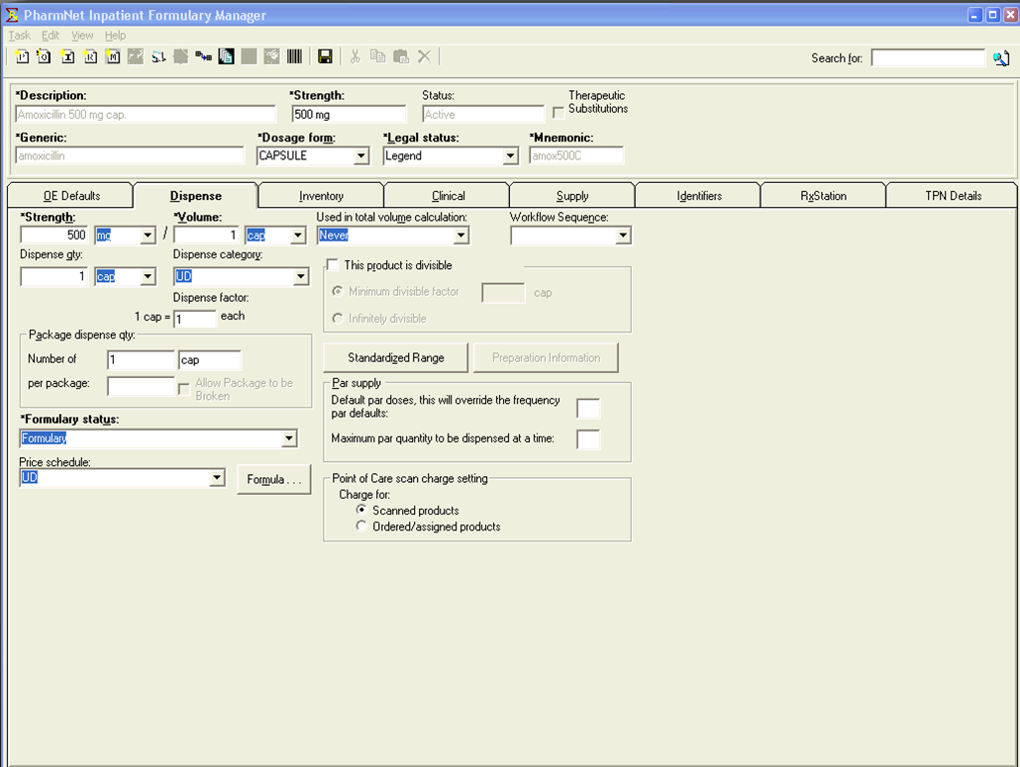
PhaDBProductMgr – Dispense Tab

Slide 9
PhaDBProductMgr – Dispense Tab (continued)
PhaDBProductMgr Field | Table | Field
Strength & Volume | Med_dispense | Strength, Strength_unit_cd, Volume, Volume_unit_cd
Dispense Qty / Unit | Med_package_type | Dispense_qty, uom_cd
Dispense Category | Med_oe_defaults | Dispense_category_cd
Dispense Factor | Med_dispense | Dispense_factor
Per Package | Med_dispense | Pkg_qty_per_pkg
Formulary Status | Med_dispense | Formulary_status_cd
Price Schedule | Med_oe_defaults | Price_sched_id
Used in Total Volume Calc | Med_dispense | Used_as_base_ind 0 = Never, 1 = Sometimes, 2 = Always
Workflow Sequence | Med_dispense | Workflow_cd
This product is divisible | Med_dispense | Divisible_ind
Minimum divisible factor | Med_dispense | Base_issue_factor

Slide 10
PhaDBProductMgr – Dispense Tab (continued)
PhaDBProductMgr Field | Table | Field
Infinitely Divisible | Med_dispense | Base_issue_factor (when equal to 0.001)
Default Par Doses | Med_dispense | Default_par_doses
Max Par Supply | Med_dispense | Max_par_supply
POC Charge Flag | Med_dispense | Poc_charge_flag (0 = Scanned Products, 1 = Ordered / Assigned Products)

Slide 11
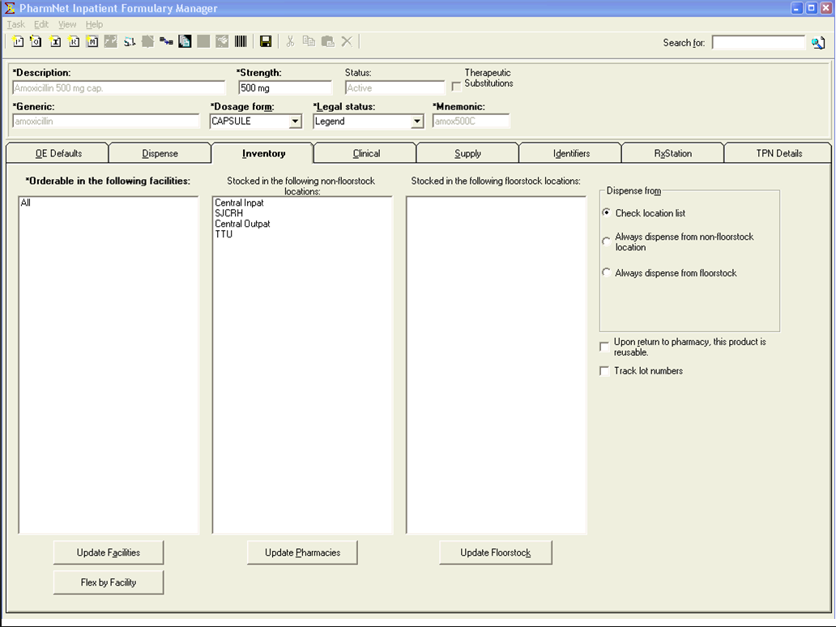
PhaDBProductMgr – Inventory Tab

Slide 12
PhaDBProductMgr – Inventory Tab (continued)
PhaDBProductMgr Field | Table | Field
Facilities | Med_flex_object_idx | Parent_entity_id
Non-Floorstock Locations | Stored_at | Location_cd
Floorstock Locations | Stored_at | Location_cd
First Dose Flag | Item_control_info | First_dose_flag
Facility Flexed – Formulary Status | Med_dispense | Formulary_status_cd
Facility Flexed – Lot Tracking | Med_dispense | Lot_tracking_ind
Dispense From | Med_dispense | Always_dispense_from_flag
Product is reusable | Med_dispense | Reusable_flag
Track Lot Numbers | Med_dispense | Lot_tracking_ind

Slide 13
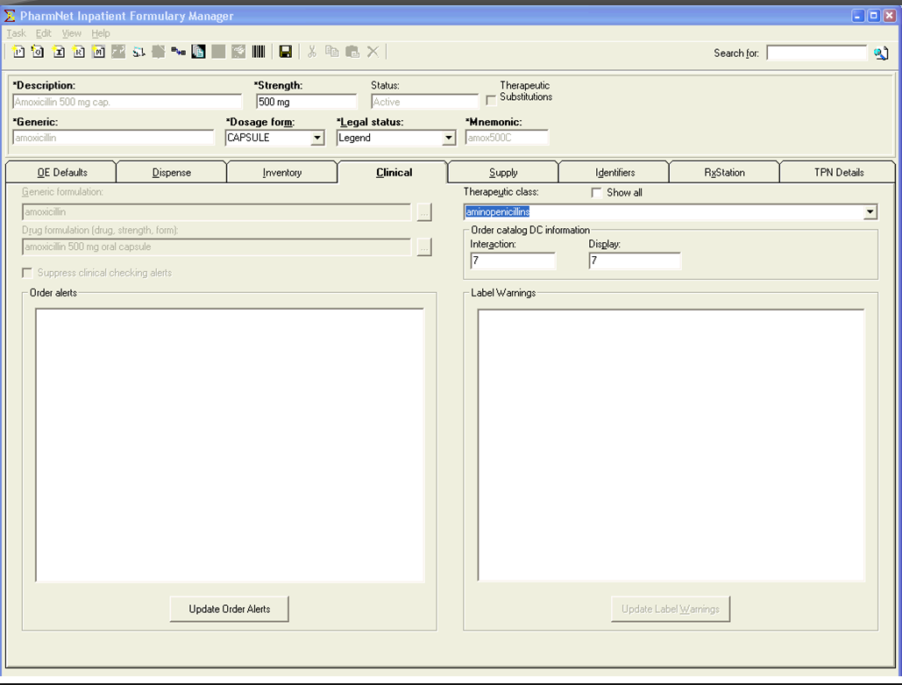
PhaDBProductMgr – Clinical Tab

Slide 14
PhaDBProductMgr – Clinical Tab (continued)
PhaDBProductMgr Field | Table | Field
Generic Formulation | Nomenclature | Source_string
Drug Formulation | Nomenclature | Source_string
Suppress Clinical Checking Alerts | Order_catalog | CKI
Therapeutic Class | Alt_sel_cat | Long_description
Order Catalog – DC Info – Interaction | Order_catalog | Dc_interaction_days
Order Catalog – DC Info – Display | Order_catalog | Dc_display_days
Order Alerts | Med_flex_object_idx | Parent_entity_id
Warning Labels | Warning_label | Label_full_txt

Slide 15
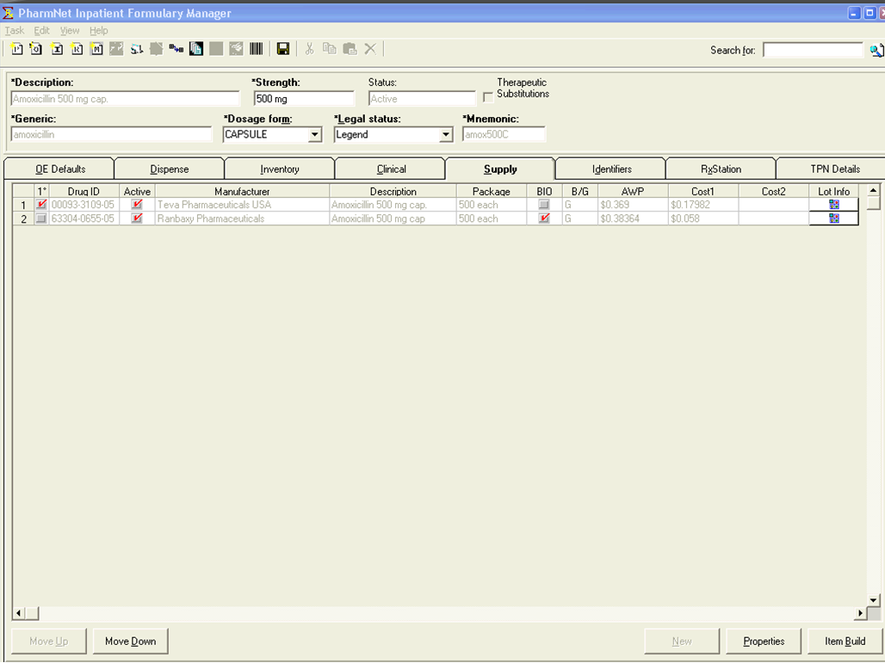
PhaDBProductMgr – Supply Tab

Slide 16
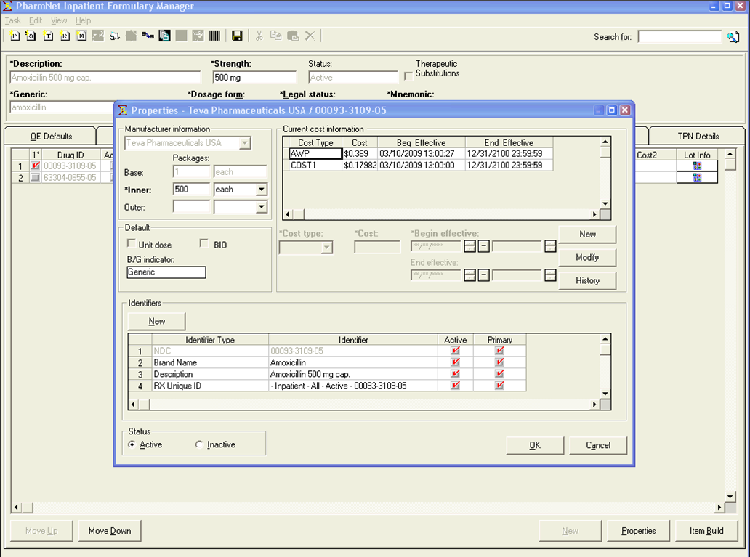
PhaDBProductMgr – Supply Properties

Slide 17
PhaDBProductMgr – Supply Properties (continued)
PhaDBProductMgr Field | Table | Field
Manufacturer | Manufacturer_item | Manufacturer_cd
Package Types | Package_type | Qty, Uom_cd
Unit Dose | Med_product | Unit_dose_flag
BIO | Med_product | Bio_equiv_flag
Brand | Med_product | Brand_flag
Identifiers | Med_identifier | Med_identifier_type_cd, Value, Active_ind, Primary_ind
Cost | Med_cost_hx | Cost_type_cd, Cost, Beg_effective_dt_tm, End_effective_dt_tm
Active Status | Med_flex_object_idx | Active_ind

Slide 18
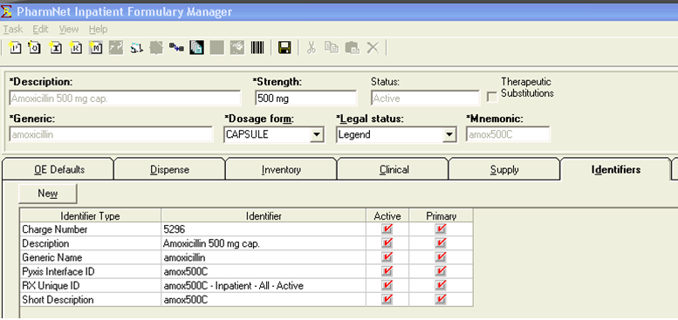
PhaDBProductMgr – Identifiers Tab
PhaDBProductMgr Field | Table | Field
Identifiers | Med_identifier | Med_identifier_type_cd, Value, Active_ind, Primary_ind

Slide 19
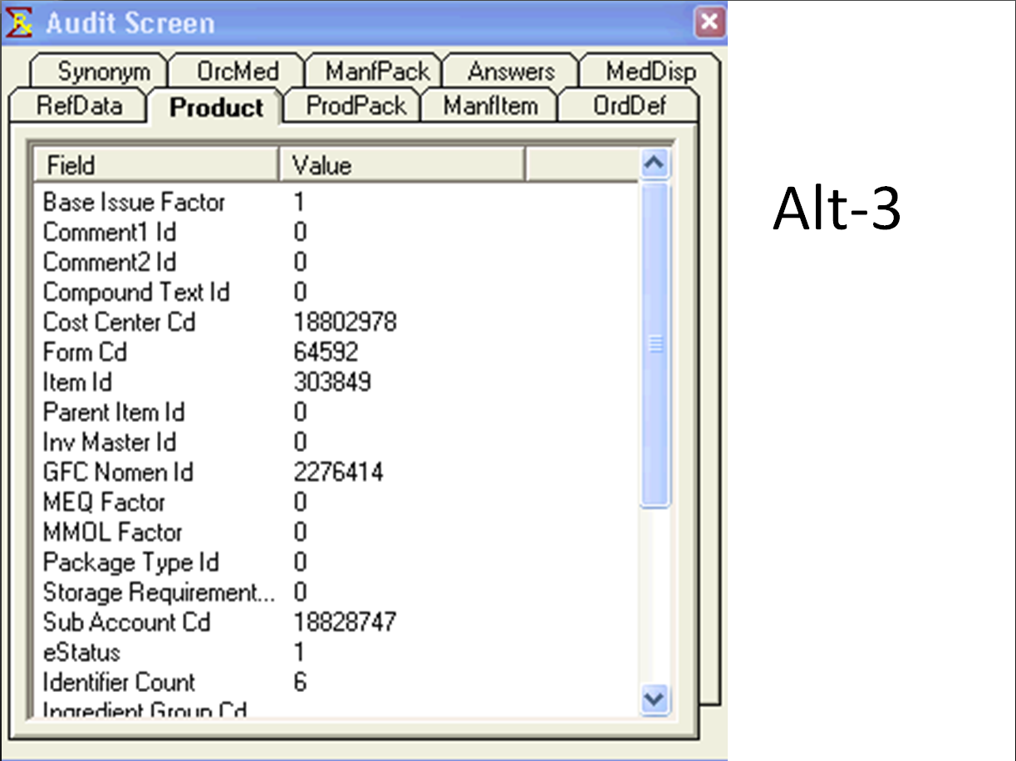
PhaDBProductMgr – Alt - 3

Slide 20
PhaDBProductMgr – Full query example

Slide 21
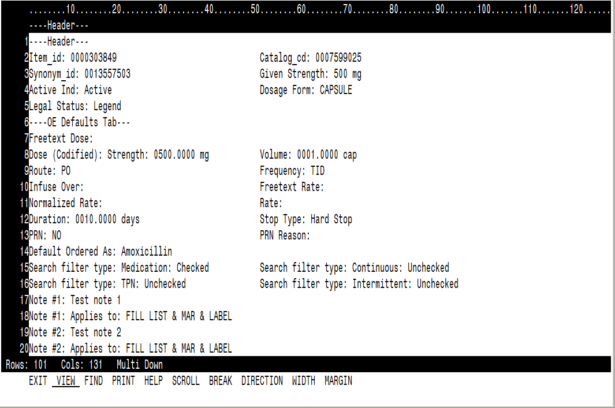
PhaDBProductMgr – Full Query

Slide 22
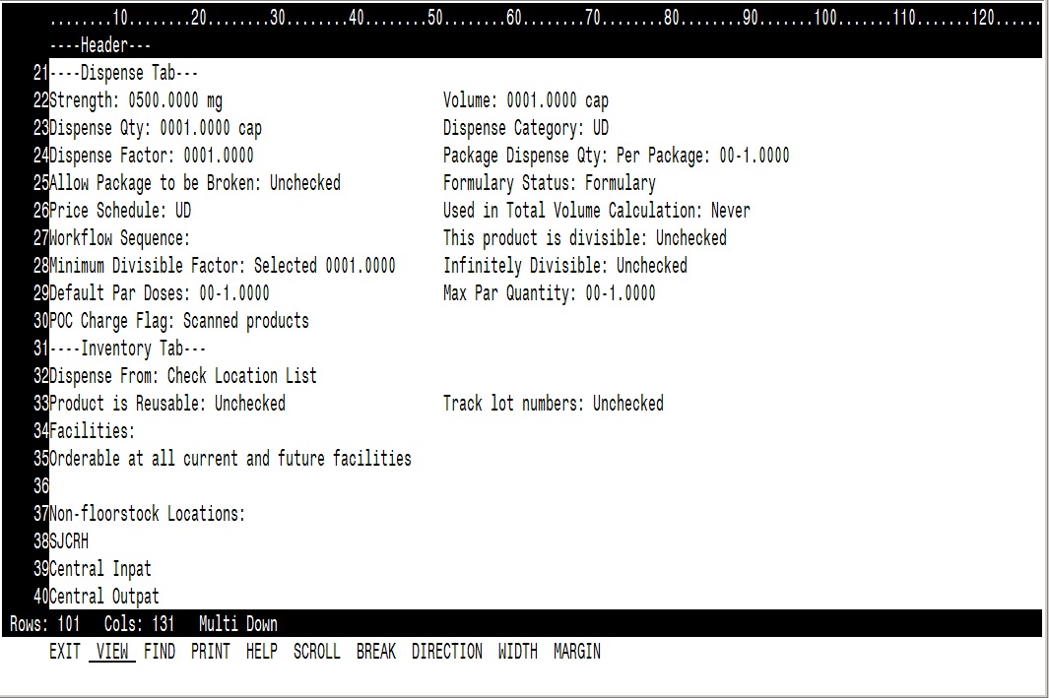
PhaDBProductMgr – Full Query (continued)

Slide 23
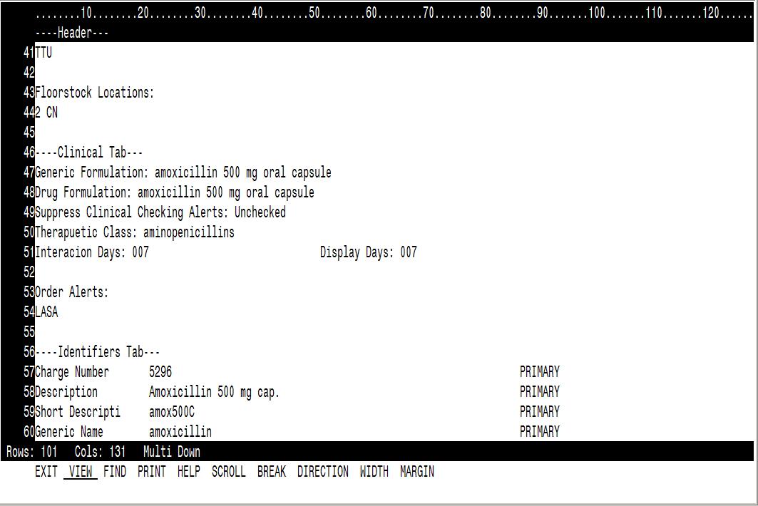
PhaDBProductMgr – Full Query (continued)

Slide 24
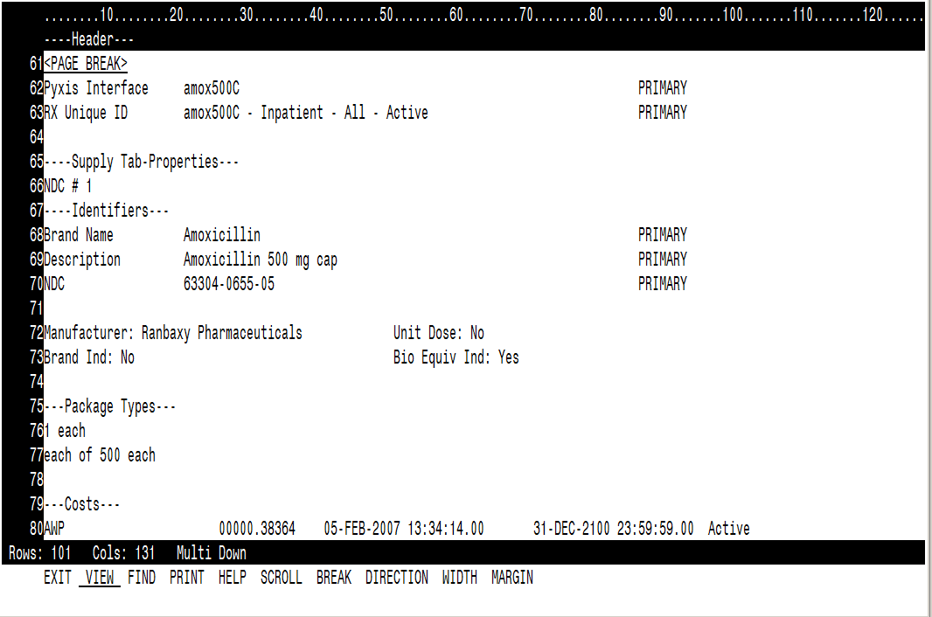
PhaDBProductMgr – Full Query (continued)

Slide 25
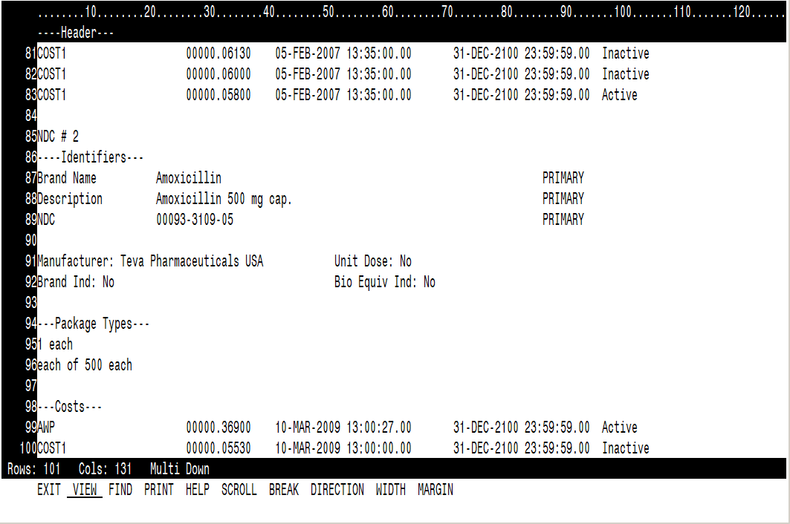
PhaDBProductMgr – Full Query (continued)

Slide 26
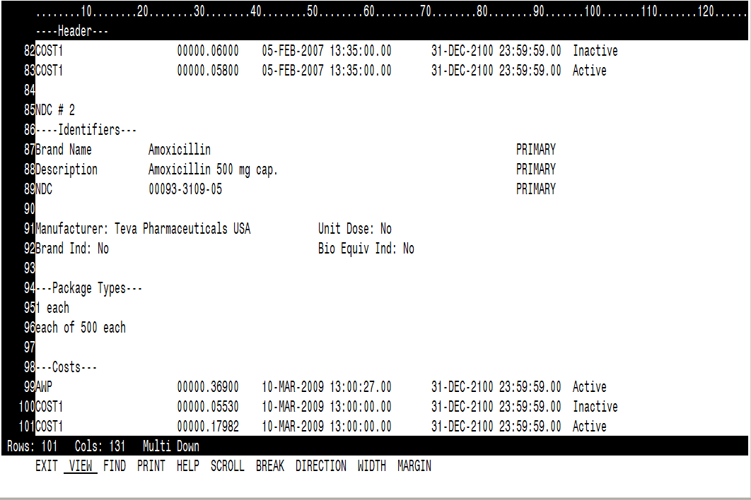
PhaDBProductMgr – Full Query (continued)

Slide 27
Medication orders
Orders table
  One row per order
  Primary key – order_id
  Other commonly important fields
    Activity_type_cd (codeset 106) Pharmacy
    Catalog_type_cd (codeset 6000) Pharmacy
    Med_order_type_cd (codeset 18309) – med, intermittent, continuous
    Clinical display line
    Last_update_provider_id – physician responsible for the order (link to PERSON table on person_id to display name of physician)
    Need_rx_verify_ind – 1 if order needs pharmacist verification, 0 if not
    Need_nurse_review_ind
    Need_doctor_cosign_ind
    Orig_ord_as_flag

Slide 28
Medication orders
Orders table
  One row per order
    Parent order – order_id of original order
      CPOE order
      Pharmacist entered order through PharmNet
      Template_order_id = 0
    Child orders
      Each EMAR task creation causes another child order to be written
      Links to the parent order through the Template_order_id field
        Template_order_id = Order_id of the parent order
  So when someone asks “Give me all of the orders for amoxicillin over the last 3 months”
    If you just want the parent orders
      filter by “where template_order_id =0”
    If you want parent and child orders
      No filter on template_order_id but you may want to sort to keep the related orders together

Slide 29
For every order there is at least one action
Order_action table
  Link from ORDERS table on order_id
  Key fields
    Action_type_cd (codeset 6003) – order, modify, discontinue, reschedule
    Action_dt_tm – the date and time of the action
    Action_personnel_id – person_id of the individual who performed the order action
    Action_sequence
  Many to one relationship with ORDERS table row
  Can often be audited for accuracy by comparing the output to the History subtab under Order_information for that order in PowerChart

Slide 30
Details, details, details
Order_detail table
  Link from ORDERS table on order_id
  Key fields
    Oe_field_meaning_id (link back to order_entry_fields table)
    Oe_field_id (link back to order_entry_fields table)
    Oe_field_value
    Action_sequence
  Many to one relationship with ORDERS table row and detail rows are added with each order action (e.g. modify, reschedule, void, etc.)
  Can often be audited from the order information tab in PowerChart using the Details subtab and/or the History subtab

Slide 31
Medication orders
Order_dispense table
  Link from ORDERS table on order_id
  Key fields
    Pharm_type_cd (codeset 4500)
    Need_rx_verify_ind here as well
    Last_ver_act_seq
    Last_ver_ingr_seq
    Legal_status_cd (codeset 4200)
  One to one relationship with the parent order row from ORDERS
  Retail PharmNet clients
    Prescription number resides on this table
      RX_NBR
      RX_NBR_CD

Slide 32
Ingredients and Products
Order_ingredient table
  Link from ORDERS table on order_id
  Key fields
    Action_sequence
    Comp_sequence
    Ingredient_type_flag
Order_product table
  One row per ingredient
  Links to ORDERS on order_id
  Key fields
    Item_id (link to MED_IDENTIFIER for description, NDC, etc.)
    Action_sequence
    Ingred_sequence

Slide 33
Ce_event_order_link & Clinical_event
Ce_event_order_link table
  Link from ORDERS table on order_id. Translates from order to results charted for that order. Could shift from template order to child order.
  Key fields
    Order_id
    Event_id
Clinical_event table
  Core table for storing documented results
  Key Fields
    Use Event_class_cd of MED can be used to determine if result is for a Medication
    Use Subtable_bit_map to determine other tables that supply more information
    Event_end_dt_tm – Time Medication was given.

Slide 34
Ce_med_result
Ce_med_result table
  Links to CLINICAL_EVENT by Event_id
  All result data specific to medications
  Key fields
    IV_event_cd – Defines type of IV event (Begin Bag, Rate change, etc)

Slide 35
Inventory Transactions
MM_trans_header table
  Link from DISPENSE_HX table is Parent_entity_id / Parent_entity_name.
  Parent table for all inventory transactions such as adjustments, transfers, and receipts.
  ORDERS table on order_id. Translates from order to results charted for that order. Could shift from template order to child order.
  Key fields
    Trans_type_cd
    Parent_entity_id / Parent_entity_name –
MM_trans_line table
  Table for storing inventory transaction details such as item_id, packaging, cost, quantity on hand, and location.
  Links to patient / encounter to drive clinical analysis of inventory transactions.

Slide 36
Inventory Transactions
  Key Fields
    Item_id, patient_id, encntr_id,
MM_trans_gl table
  Table for storing general ledger details such as cost center, subaccount, cost, and amount.
  Key Fields
    From/to_cost_center, from/to_sub_account, amount

Slide 37
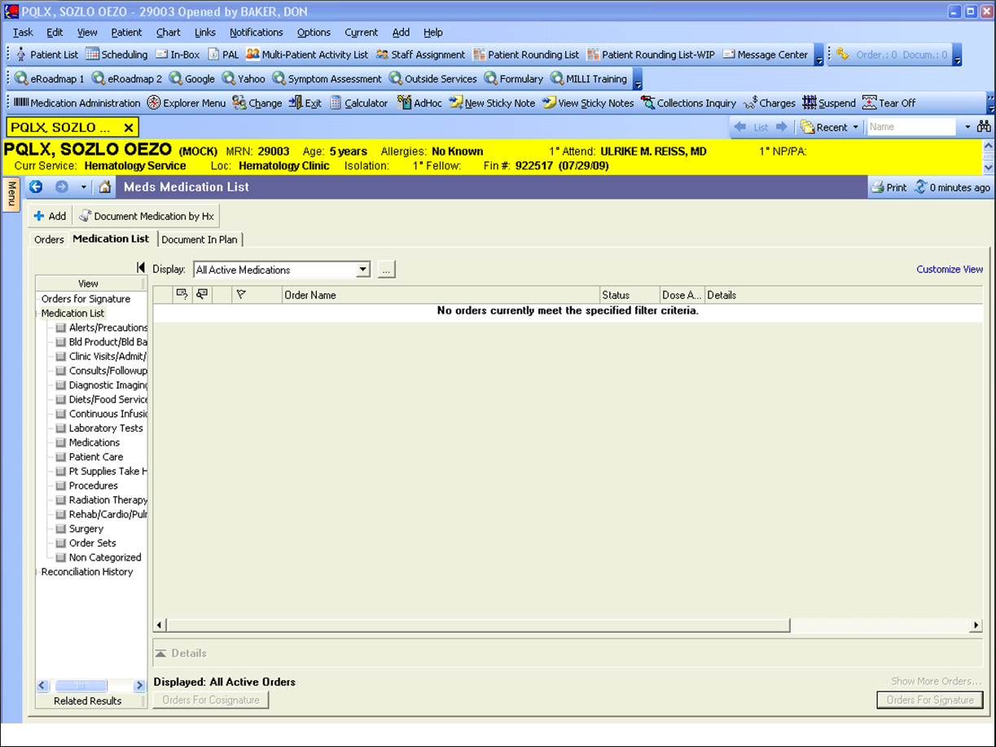
Power Orders – Patient selected

Slide 38
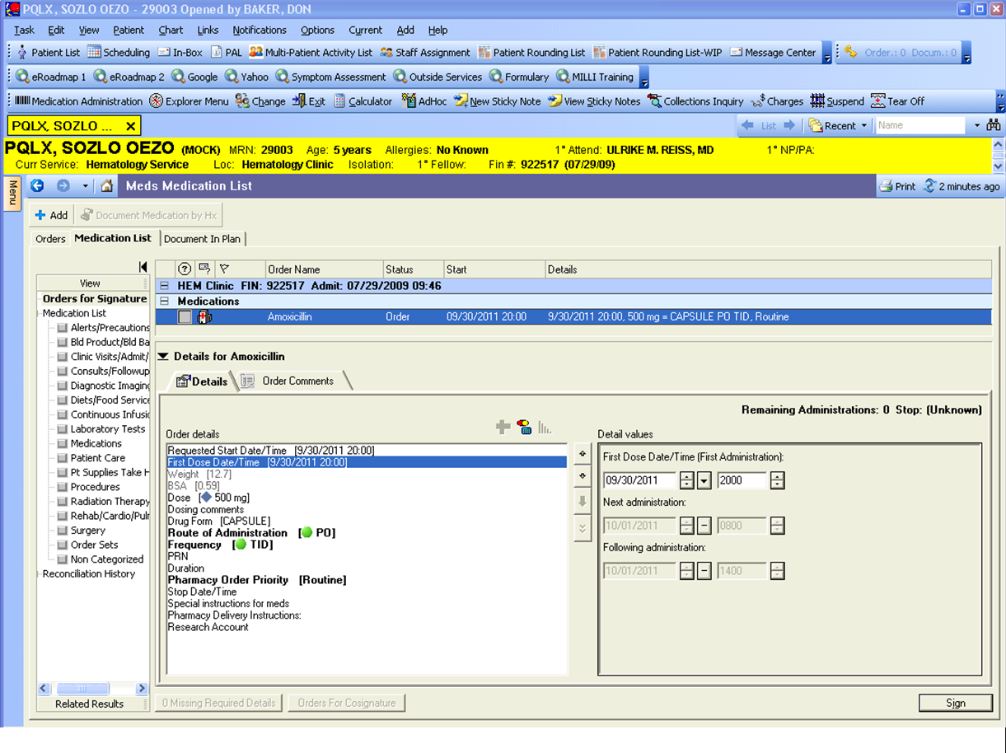
Power Orders – New order

Slide 39
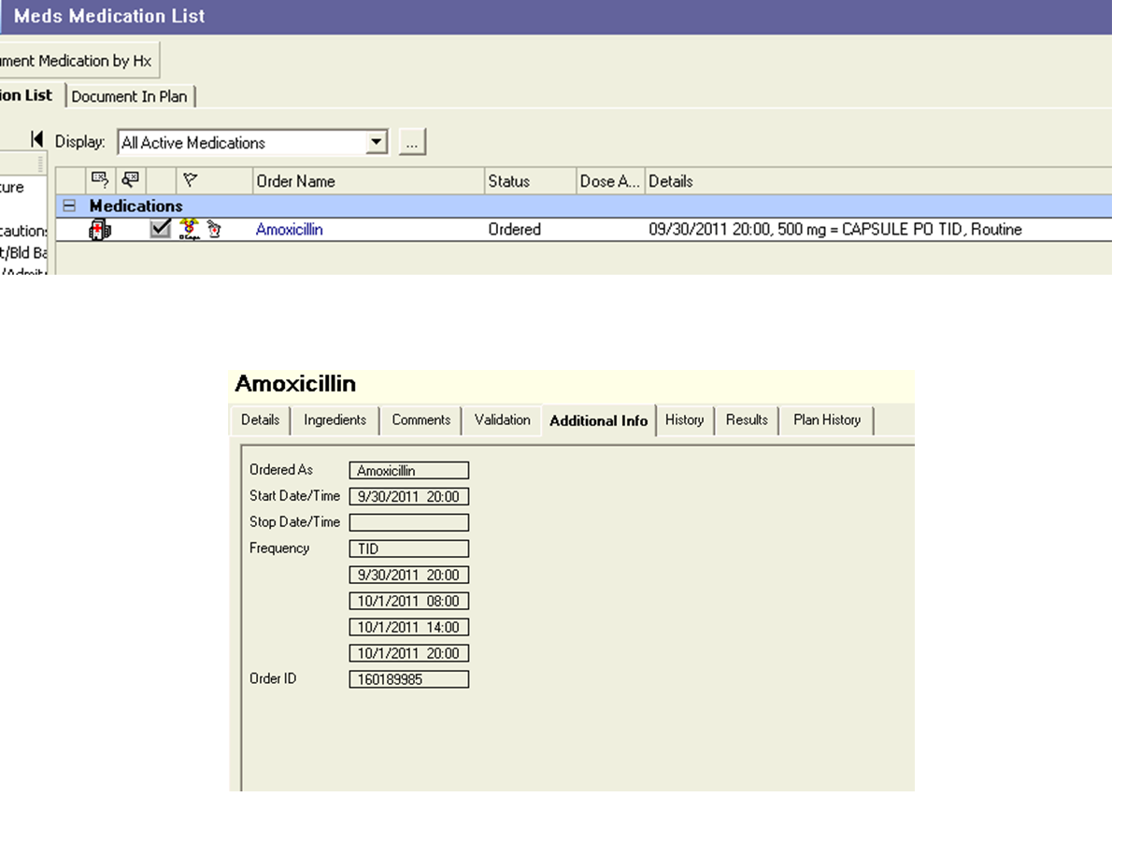
Power Orders – Profile & Additional Info

Slide 40
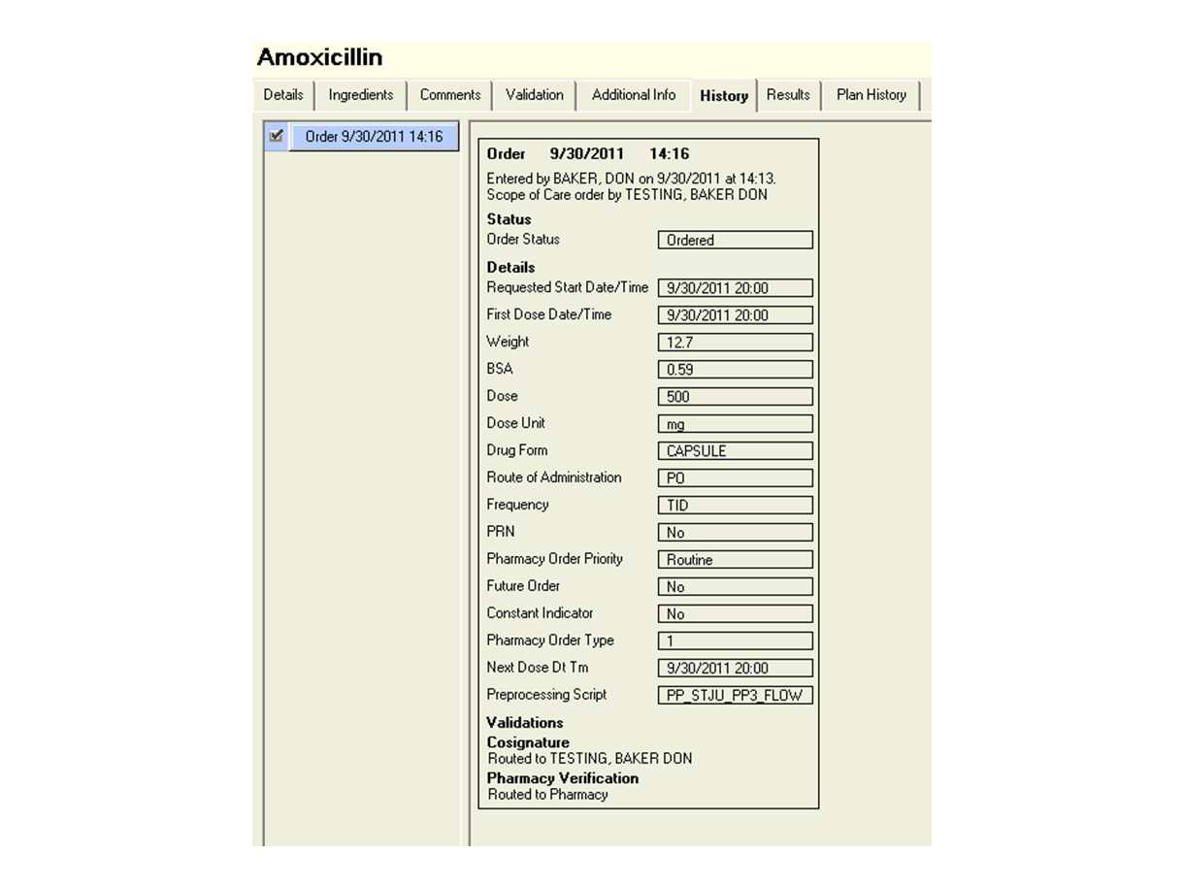
Power Orders – History

Slide 41
Orders Database
Orders – Stores all orders
Order_id
Order_dispense – Stores Pharmacy fields for each order
Order_action – Stores all actions for an order (Order, Modify, DC, Cancel, etc)
Order_id
Order_id
Action_sequence
Order_ingredient– Stores ingredients for an order
Order_id
Action_sequence
Comp_sequence
Order_detail– Stores all Order Entry fields
Order_id
Action_sequence
Detail_sequence
Order_review – Stores review events (Doctor, Nurse and Pharmacy)
Order_product– Stores products per each ingredient
Order_id
Action_sequence
Review_sequence
Order_id
Action_sequence
Ingred_sequence

Slide 42
Power Orders – Orders Table
Field | Value | Field | Value
Order_id | 160189985 | Activity_type_cd | 3823 (Pharmacy)
OE_format_id | 7706659 | Order_detail_display_line | 09/30/11 20:00, 12.7, 0.59, 500 mg CAPSULE PO TID, Routine, -1, 1, 09/30/11 20:00, PP_STJU_PP3_FLOW, 294,893
Encntr_id | 12614704 | Template_order_id | 0
Person_id | 9640430 | Temlate_order_flag | 1
Catalog_cd | 7599025 (Amoxicillin) | Synonym_id | 7599026
Suspend_ind | 0 | IV_ind | 0
Contributor_system_cd | 2476 (POWERCHART) | Constant_ind | 0
Catalog_type_cd | 2776 (Pharmacy) | PRN_ind | 0
Orig_order_dt_tm | 09/30/11 | Order_comment_ind | 0
Order_status_cd | 1177 (Ordered) | Need_rx_verify_ind | 1
Order_mnemonic | Amoxicillin | Need_nurse_review_ind | 0
Last_action_sequence | 1 | Need_doctor_cosign | 0
Last_update_provider_id | 1030007 | Current_start_dt_tm | 09/30/11

Slide 43
Power Orders – Orders Table
Field | Value | Field | Value
Projected_stop_dt_tm |  | Discontinue_type_cd | 0
Suspend_effective_dt_tm |  | Rx_mask | 4
Resume_ind | 0 | Dept_misc_line | Amoxicillin 500 mg CAPSULE PO TID
Resume_effective_dt_tm |  | CKI | MUL.ORD!d00088
Discontinue_ind | 0 | Med_order_type_cd | 262978 (MED)
Discontinue_effective_dt_tm |  | Ned_physician_validate_ind | 0
Cs_order_id | 0 | Ordered_as_mnemonic | Amoxicillin
Cs_flag | 0 | Soft_stop_dt_tm
HNA_order_mnemonic | Amoxicillin | Eso_new_order_ind | 0
Orig_ord_as_flag | 0 | Frequency_id | 294893 (TID)
Ingredient_ind | 0 | Freq_type_flag | 1
Dept_status_cd | 2636 (Ordered) | Last_core_action_sequence | 1
Ref_text_mask | 64 | Stop_type_cd | 0
Clinical_display_line | 09/30/11 20:00, 500 mg = CAPSULE PO TID, Routine | Template_core_action_sequence | 0

Slide 44
Power Orders – Orders Table
Field | Value | Field | Value
Incomplete_order_ind | 0 | Day_of_treatment_sequence | 0
Last_ingred_action_sequence | 1 | Formulary_status_cd | 0
Comment_type_mask | 0 | Dosing_method_flag | 0
Override_flag | 0 | Warning_level_bit | 0
Remaining_dose_cnt | 0 | Template_dose_sequence | 0
Valid_dose_dt_tm | 10/01/11 | Last_communication_type_cd | 7481283 (Scope of Care)
Ad_hoc_order_flag | 0
Simplified_display_line | 500 mg, PO, TID
Need_rx_clin_review_flag | 1
IV_set_synonym_id | 0
Clin_relavant_updt_dt_tm | 09/30/11
Future_liocation_facility_cd | 0
Future_location_nurse_cd | 0

Slide 45
Power Orders – Order Action Table
Field | Value | Field | Value
Order_id | 160189985 | Order_provider_id | 1030007
Action_sequence | 1 | Incomplete_order_ind | 0
Communication_type_cd | 7481283 (Scope of Care) | Order_app_nbr | 600005
Action_rejected_ind | 0 | Order_action_id | 160189988
Order_conversation_id | 160189986 | Needs_verify_ind | 1
Contributor_system_cd | 2476 (POWERCHART) | Inactive_flag | 0
Order_convs_seq | 1 | Order_status_cd | 1177 (Ordered)
Order_locn_cd | 10384 (2 SE) | Dept_status_cd | 2636 (Ordered)
Action_type_cd | 1167 (Order) | Sch_state_cd | 8915 (Unscheduable)
Order_dt_tm | 09/30/11 | Eso_action_cd | 3780294 (ESO Script Skip Outbound Event )
Action_dt_tm | 09/30/11 | Medstudent_action_ind | 0
Action_personnel_id | 28 | Order_detail | 09/30/11 20:00, 09/30/11 20:00, 12.7 0.59, 500 mg CAPSULE PO TID, Routine, 01, 1, 09/30/11 20:00, PP_STJU_PP3_FLOW, 294, 8
Effetive_dt_tm | 09/30/11 | Undo_action_type_cd | 0

Slide 46
Power Orders – Order Action Table
Field | Value | Field | Value
Clinical_display_line | 09/30/11 20:00, 500 mg = CAPSULE PO TID, Routine | Action_qualifier_cd | 0
Core_ind | 1 | Current_start_dt_tm | 09/30/11
Constant_ind | 0 | Valid_dose_dt_tm | 10/01/11
Frequency_id | 294893 (TID) | Next_dose_dt_tm | 09/30/11
PRN_ind | 0 | Source_dot_order_id | 0
Stop_type_cd | 0 | Source_dot_action_seq | 0
Template_order_flag | 1 | Source_protocol_action_seq | 0
Supervising_provider_id | 0 | Formulary_status_cd | 0
Digital_signature_ident |  | Billing_provider_flag | 0
Projected_stop_dt_tm
Simplified_display_line | 500 mg, PO, TID
Need_clin_review_flag | 1
Action_initiated_dt_tm

Slide 47
Power Orders – Order Ingredient Table
Field | Value | Field | Value
Order_id | 160189985 | Freq_cd | 0
Action_sequence | 1 | IV_seq | 0
Comp_sequence | 1 | Dose_quantity | 0
Catalog_type_cd | 2776 (Pharmacy) | Dose_quantity_unit | 0
Catalog_cd | 7599025 (Amoxicillin) | Ordered_as_mnemonic | Amoxicillin
Synonym_id | 7599026 | Supplied_as_mnemionic
Order_mnemonic | Amoxicillin | HNA_Order_mnemonic | Amoxicillin
Order_detail_display_line | 500 mg | Ingredient_type_flag | 1
Strength | 500 | Clinically_significant_flag | 2
Strength_unit_cd | 504 (mg) | Include_in_total_volume | 0
Volume | 0 | Ordered_dose_unit_cd | 0
Volume_unit_cd | 0 | Ordered_dose | 0
Freetext_dose |  | Dose_calculator_long_text_id | 0

Slide 48
Power Orders – Order Ingredient Table
Field | Value | Field | Value
Ingredient_source_flag | 0
Normalized_rate | 0
Normalized_rate_unit_cd | 0
Concentration | 0
Concentration_unit_cd | 0
Dosing_capacity | 0
Dose_adjustment_display
Days_of_administration_display

Slide 49
Power Orders – Order Detail Table
Action_seq | Detail_seq | OE_Field_display_value | OE_field_dt_tm_value | OE_field_id | OE_field_meaning | OE_field_value | Order_id | OE_field_meaning_id | Parent_action_seqiuence
1 | 1 | 09/30/11 20:00 | 09/30/11 | 13522014 | REFERRENCESTARTDTTM | 0 | 160189985 | 146 | 1
1 | 2 | 09/30/11 20:00 | 09/30/11 | 4507 | REQSTRATDTTM | 0 | 160189985 | 51 | 1
1 | 3 | 12.7 |  | 4606 | WEIGHT | 12.70 | 160189985 | 99 | 1
1 | 4 | 0.59 |  | 7419738 | OTHER | 0.59 | 160189985 | 9000 | 1
1 | 5 | 500 |  | 4662 | STRENGTHDOSE | 500 | 160189985 | 2056 | 1
1 | 6 | mg |  | 4663 | STRENGTHDOSEUNIT | 504 | 160189985 | 2057 | 1
1 | 7 | CAPSULE |  | 4646 | DRUGFORM | 64592 | 160189985 | 2014 | 1
1 | 8 | PO |  | 4659 | RXROUTE | 84987 | 160189985 | 2050 | 1
1 | 9 | TID |  | 4644 | FREQ | 252498 | 160189985 | 2011 | 1
1 | 10 | No |  | 4654 | SCH/PRN | 0 | 160189985 | 2037 | 1
1 | 11 | Routine |  | 6624712 | RXPRIORITY | 7532947 | 160189985 | 141 | 1
1 | 12 | -1 |  | 9474 | ADHOCFREQINSTANCE | -1 | 160189985 | 2071 | 1

Slide 50
Power Orders – Order Detail Table
Action_seq | Detail_seq | OE_Field_display_value | OE_field_dt_tm_value | OE_field_id | OE_field_meaning | OE_field_value | Order_id | OE_field_meaning_id | Parent_action_seqiuence
1 | 13 | No |  | 9469 | FUTUREORDER | 0 | 160189985 | 120 | 1
1 | 14 | No |  | 4613 | CONSTANTIND | 0 | 160189985 | 114 | 1
1 | 15 | 1 |  | 9470 | PHARMORDERTYPE | 1 | 160189985 | 2070 | 1
1 | 16 | 09/30/11 20:00 | 09/30/11 | 4586010 | NEXTDOSEDTTM | 0 | 160189985 | 2096 | 1
1 | 17 | PP_STJU_PP3_FLOW |  | 6624710 | PREPROCESSSCRIPT | 0 | 160189985 | 4 | 1
1 | 18 | 294,893 |  | 4586008 | FREQSCHEDID | 294893 | 160189985 | 2094 | 1

Slide 51
Power Orders – Order Review Table
Orders Field | Value | Value
Order_id = 160189985, Action_sequence = 1 | Review_sequence = 1 | Review_sequence = 2
Review_type_flag | 3 (Phamacy) | 2 (Physician)
Review_reqd_ind | 1 | 0
Provider_id | 0 | 1030007
Location_cd | 0 | 0
Dept_cd | 0 | 0
Reviewed_status_flag | 0 | 0
Review_personnel_id | 0 | 0
Review_dt_tm
Proxy_personnel_id | 0 | 0
Proxy_reason_cd | 0 | 0
Reject_reason_cd | 0 | 0
Digital_signature_ident
Review_grp_value | 0 | 0

Slide 52
Power Orders – Order Dispense Table
Field | Value | Field | Value
Order_id | 160189985 | Price_schedule_id | 0
Next_dispense_dt_tm | 09/30/11 | Order_cost_value | 0
Dispense_category_cd | 0 | Order_price_value | 0
Encntr_id | 12614704 | Order_dispense_ind | 1
Prn_ind | 0 | Cart_fill_doses1 | 0
Print_ind | 1 | Cart_fill_dt_tm1
Total_dispense_doses | 0 | Cart_fill_run_id1 | 0
Next_iv_sep | 0 | Cart_fill_doses2 | 0
Floorstock_ind | 0 | Cart_fill_dt_tm2
Frequency_id | 0 | Cart_fill_run_id2 | 0
Par_doses | 0 | Cart_fill_dt_doses3 | 0
IV_set_size | 0 | Cart_fill_dt_tm3
Replace_every | 0 | Cart_fill_run_id3 | 0
Replace_every_cd | 0 | Floorstock_override_ind | 0

Slide 53
Power Orders – Order Dispense Table
Field | Value | Field | Value
Dept_status_cd | 0 | Unverified_comm_type_cd | 7481283
Display_line | Amoxicillin 500 mg CAPSULE PO TID | Unverified_action_type_cd | 1167 (Ordered)
Ignore_ind | 0 | Unverified_route_cd | 84987 (PO)
Last_ver_act_seq | 0 | Unverified_rx_ord_priority_cd | 7532947 (Routine)
Last_ver_ingr_seq | 0 | Profile_display_dt_tm | 12/31/00
Order_type | 1 | Future_loc_facility_cd | 0
Resume_dt_tm |  | Future_loc_nurse_unit_cd | 0
Stop_dt_tm |  | Need_rx_prod_assign_flag | 1
Stop_type_cd | 0 | Last_clin_review_act_seq | 0
Suspend_dt_tm |  | Last_clin_review_ingr_seq | 0
Pharm_type_cd | 6600991 (Inpatient) | Workflow_cd | 0
Person_id | 9640430 | Patient_med_ind | 0
Research_account_id | 0 | Start_dispense_dt_tm
Need_rx_verify_ind | 1 | Auto_credit_ind | 0

Slide 54
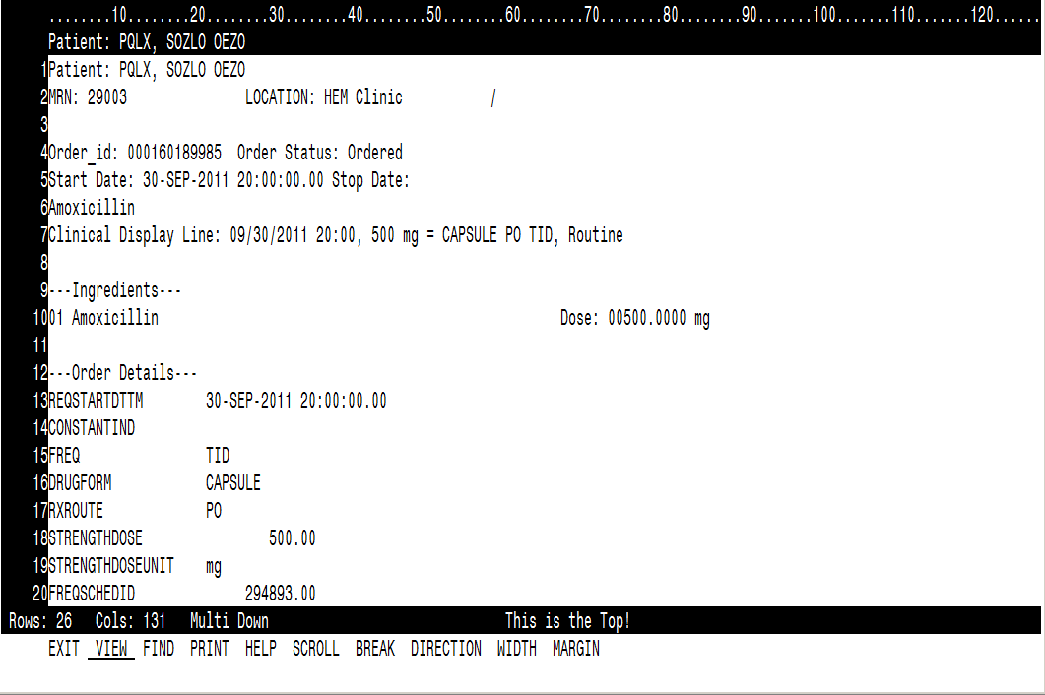
Power Orders – Full Query

Slide 55
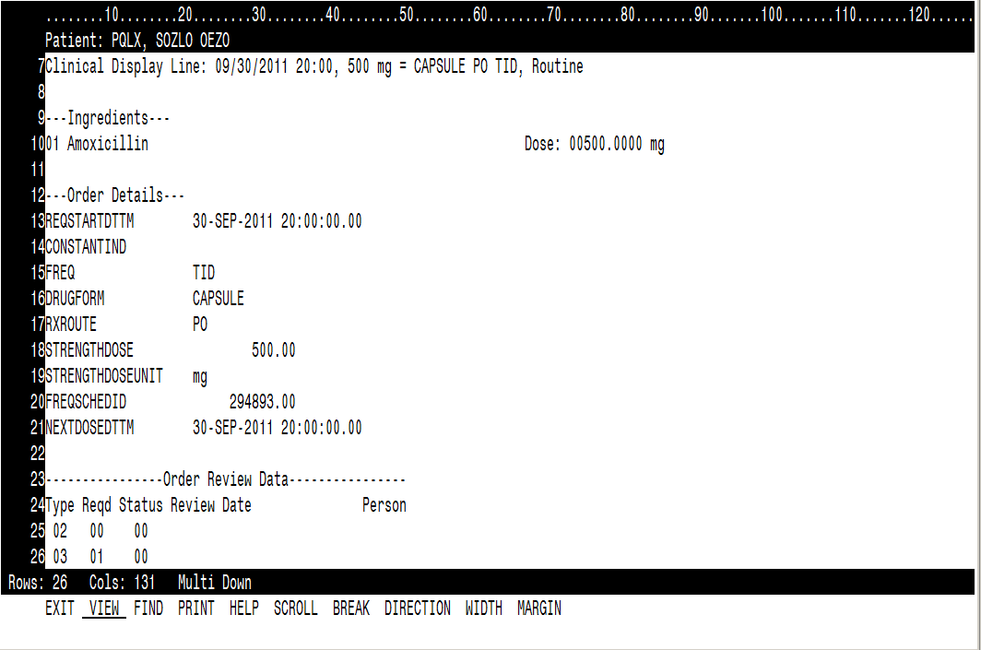
Power Orders – Full Query (continued)

Slide 56
Power Orders – Full query example

Slide 57
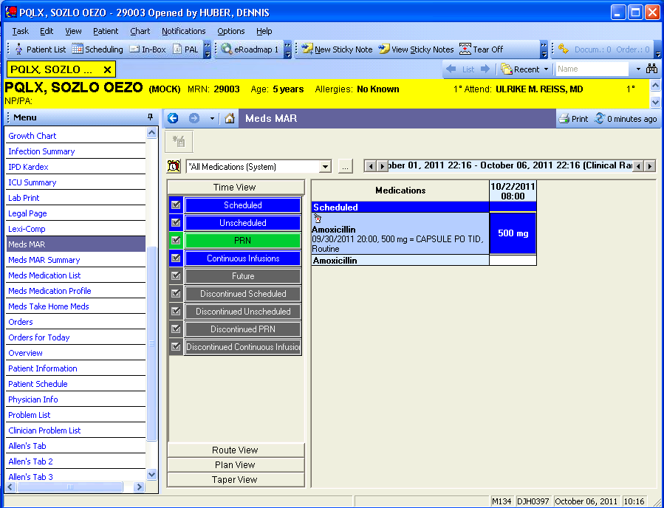
Power Orders – EMAR

Slide 58
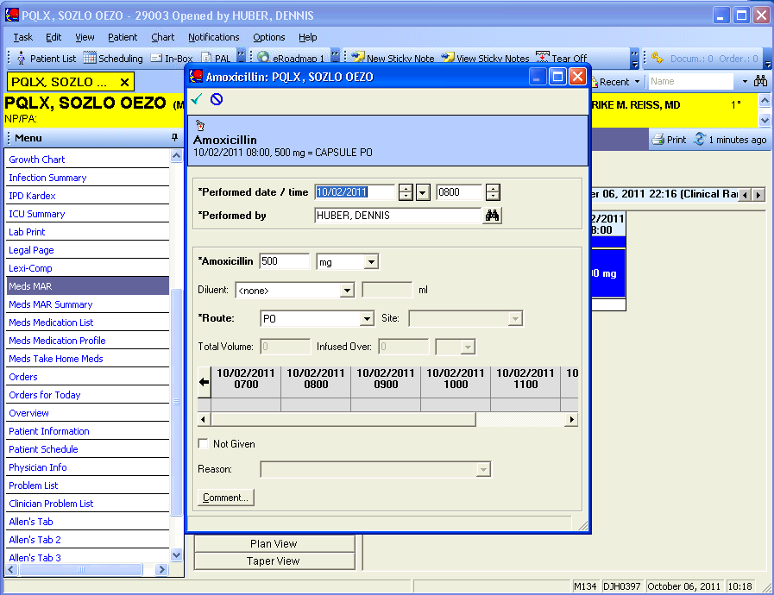
Power Orders – EMAR

Slide 59
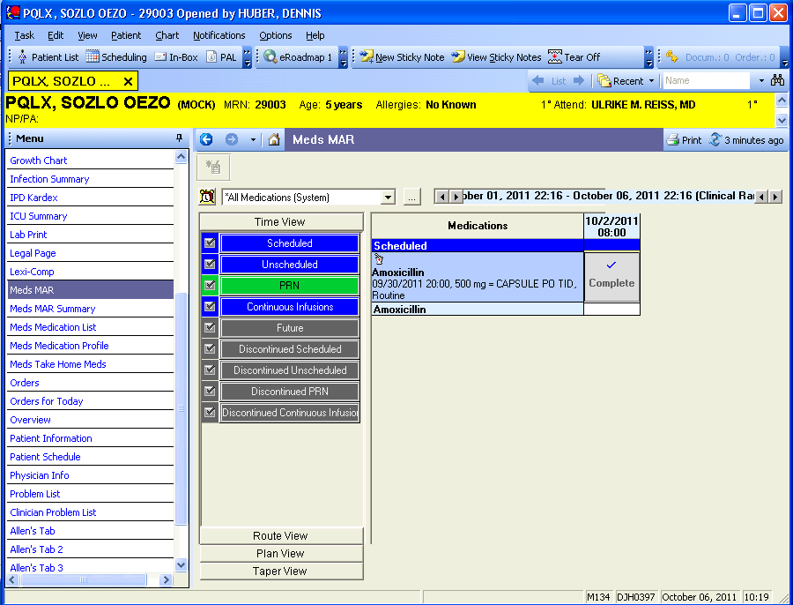
Power Orders – EMAR

Slide 60
EMAR – Ce_event_order_link table
Field | Value | Field | Value
Event_id | 219162267 & 219162269
Order_id | 160190769
Order_action_sequence | 1
Valid_unitil_dt_tm | 12/31/00
Valid_from_dt_tm | 10/06/11
Parent_order_ident | 160189985
Event_end_dt_tm | 10/02/11
Person_id | 9640430
Catalog_type_cd | 2776 (Pharmacy)
Encntr_id | 12614704

Slide 61
EMAR – Clinical_event table
Field | Value | Field | Value
Clinical_event_id | 219162290 | Valid_from_dt_tm | 11/06/01
Encntr_id | 12614704 | Event_class_cd | 580 (MED)
Person_id | 9640430 | Event_cd | 8026333 (Amoxicillin)
Event_start_dt_tm |  | Event_tag | 250 mg
Event_id | 219162269 | Event_end_dt_tm | 10/02/11
Valid_until_dt_tm | 12/31/00 | Result_val | 250.0
Event_title_text | Amoxicillin | Result_units_cd | 504 (mg)
View_level | 1 | Record_status_cd | 4216 (Active)
Order_id | 160190769 | Result_status_cd | 660 (Modified)
Catalog_cd | 7599025 (Amoxicillin) | Authentic_flag | 1
Series_ref_nbr |  | Publish_flag | 1
Contributor_system_cd | 2476 (POWERCHART) | Qc_review_cd | 0
Parent_event_id | 219162267 | Verified_dt_tm | 10/06/11
Event_reltn_cd | 631 (CHILD) | Verified_prsnl_id | 10319921

Slide 62
EMAR – Clinical_event table
Field | Value | Field | Value
Performed_dt_tm | 10/06/11
Performed_prsnl_id | 10319921
Clinsig_updt_dt_tm | 10/06/11
Order_action_sequence | 1
Entry_mode_cd | 22993752 (MedAdmin)
Subtable_bit_map | 1074266117
Collating_seq | 1

Slide 63
EMAR – Ce_med_result table
Field | Value | Field | Value
Event_id | 219162269 | Initial_volume | 0
Valid_until_dt_tm | 12/31/00 | Total_intake_volume | 0
Admin_start_dt_tm | 10/02/11 | Diluent_type_cd | 0
Valid_from_dt_tm | 10/06/11 | Ph_dispense_id | 0
Admin_note |  | Infusion_rat | 0
Admin_prov_id | 0 | Infusion_unit_cd | 0
Admin_end_dt_tm | 10/02/11 | Infusion_time_cd | 0
Admin_route_cd | 84987 (PO) | Medication_form_cd | 0
Admin_site_cd | 0 | Reason_required_flag | 0
Admin_method_cd | 0 | Response_required_flag | 0
Admin_pt_loc_cd | 0 | Admin_strength | 0
Initial_dosage | 0 | Admin_strength_unit_cd | 0
Admin_dosage | 500 | Substance_lot_number
Dosage_unit_cd | 504 (mg) | Substance_exp_dt_tm

Slide 64
EMAR – Ce_med_result table
Field | Value | Field | Value
Substance_manufacturer_cd | 0
Refusal_cd | 0
System_entry_dt_tm | 10/06/11
Iv_event_cd | 0
Infused_volume | 0
Infused_volume_unit_cd | 0
Remaining_volume | 0
Remaining_volume_unit_cd | 0
Synonym_id | 7599026
Immunization_type_cd | 0
Weight_value | 0
Weight_unit_cd | 0

Slide 65
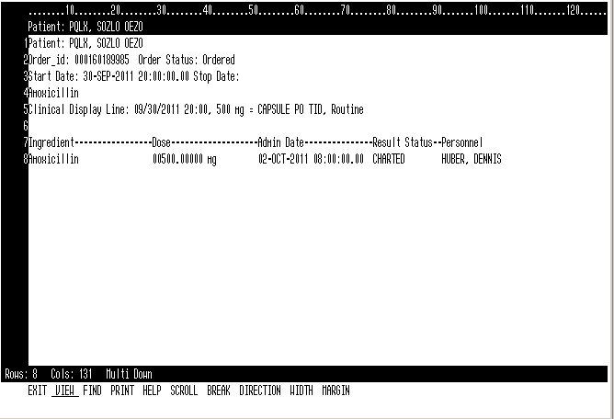
Power Orders – EMAR Full Query

Slide 66
Power Orders – EMAR – Full Query example

Slide 67
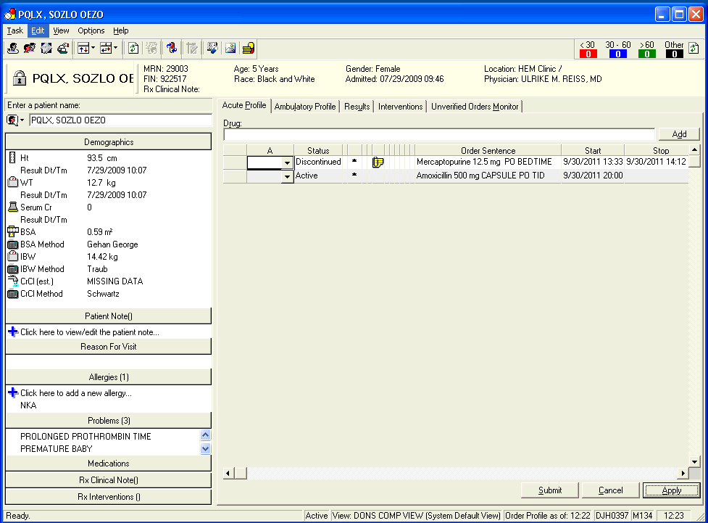
PhaMedMgr – Verification

Slide 68
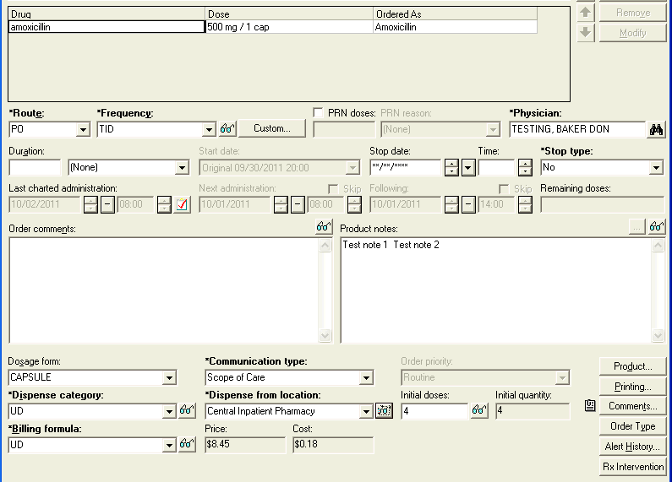
PhaMedMgr – Verification

Slide 69
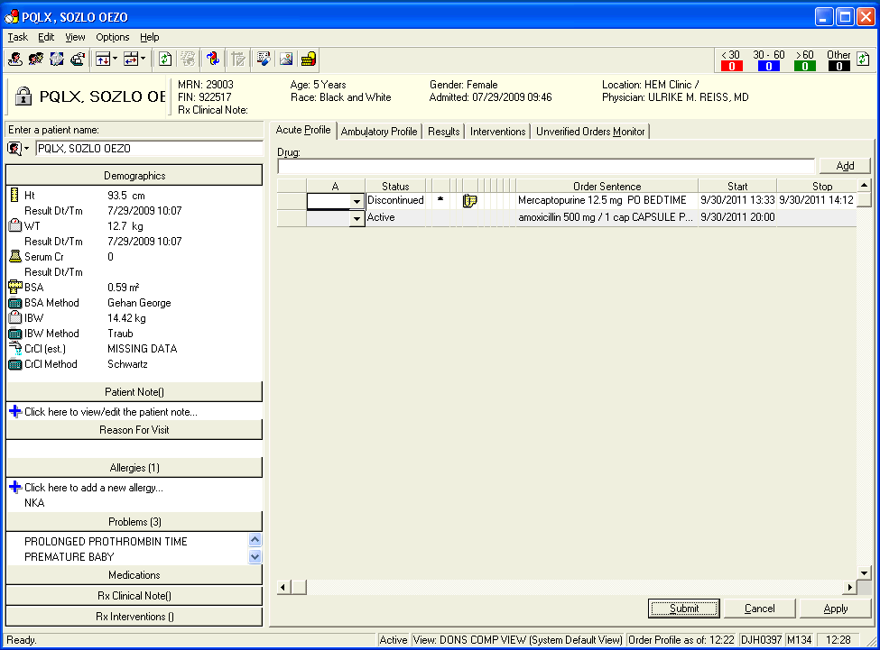
PhaMedMgr – Verification

Slide 70
PhaMedMgr – Verify - Orders (only changed fields)
Field | Value | Field | Value
Last_action_sequence | 2
Order_detail_display_line | 09/30/2011 20:00, 09/30/2011 20:00, 12.7 0.59, 500 mg 1 cap CASULE PO TID, Routine, 01, UD, 0, 1, 10/06/2011 14:00
Order_comment_ind | 1
Need_rx_verify_ind | 0
Dept_misc_line | Amoxicillin 500 mg / 1 cap CAPSULE PO TID
Last_core_action_sequence | 2
Last_ingred_action_sequence | 2
Comment_type_mask | 18
Need_rx_clin_review_flag | 2
Clin_relevant_updt_dt_tm | 10/06/11

Slide 71
PhaMedMgr - Verification – Order_dispense Table
Field | Value | Field | Value
Dispense_category_cd | 16794520 (UD) | Unverified_route_cd | 0
Total_dispense_doses | 4 | Need_rx_prod_assign_flag | 2
Frequency_id | 294893 (TID) | Last_clin_review_act_seq | 2
Price_schedule_id | 306865 (UD) | Last_clin_review_ingr_seq | 2
Order_cost_value | 0.18
Order_price_value | 8.45
Cart_fill_doses1 | 4
Cart_fill_run_id1 | 12049682
Display_line | Amoxicillin 500 mg / 1 cap CAPSULE PO TID
Last_ver_act_seq | 2
Last_ver_ingr_seq | 2
Need_rx_verify_ind | 0
Unverified_comm_type_cd | 0
Unverified_action_type_cd | 0

Slide 72
PhaMedMgr - Verify – Order_action (new)
Field | Value | Field | Value
Order_id | 160189985 | Order_provider_id | 1030007
Action_sequence | 2 | Incomplete_order_ind | 0
Communication_type_cd | 7481283 (Scope of Care) | Order_app_nbr | 600005
Action_rejected_ind | 0 | Order_action_id | 160195140
Order_conversation_id | 160195139 | Needs_verify_ind | 0
Contributor_system_cd | 2476 (POWERCHART) | Inactive_flag | 0
Order_convs_seq | 2 | Order_status_cd | 1177 (Ordered)
Order_locn_cd | 0 | Dept_status_cd | 2636 (Ordered)
Action_type_cd | 1166 (Modify) | Sch_state_cd | 8915 (Unscheduleable)
Order_dt_tm | 10/06/11 | Eso_action_cd | 1167 (Order)
Action_dt_tm | 10/06/11 | Medstudent_action_ind | 0
Action_personnel_id | 10319921 | Order_detail | 09/30/11 20:00, 09/30/11 20:00, 12.7 0.59, 500 mg 1 cap CAPSULE PO TID, Routine, 01, 1, 10/06/11 14:00, 4, Central
Effetive_dt_tm | 10/06/11 | Undo_action_type_cd | 0

Slide 73
PhaMedMgr - Verify – Order_action (new)
Field | Value | Field | Value
Clinical_display_line | 09/30/11 20:00, 500 mg = 1 cap CAPSULE PO TID, Routine | Action_qualifier_cd | 0
Core_ind | 1 | Current_start_dt_tm | 09/30/11
Constant_ind | 0 | Valid_dose_dt_tm | 10/01/11
Frequency_id | 294893 (TID) | Next_dose_dt_tm | 10/06/11
PRN_ind | 0 | Source_dot_order_id | 0
Stop_type_cd | 0 | Source_dot_action_seq | 0
Template_order_flag | 1 | Source_protocol_action_seq | 0
Supervising_provider_id | 0 | Formulary_status_cd | 0
Digital_signature_ident |  | Billing_provider_flag | 0
Projected_stop_dt_tm
Simplified_display_line | 500 mg, 1 cap, PO, TID
Need_clin_review_flag | 2
Action_initiated_dt_tm | 10/06/11

Slide 74
PhaMedMgr - Verify – Order_ingredient (new)
Field | Value | Field | Value
Order_id | 160189985 | Freq_cd | 0
Action_sequence | 2 | IV_seq | 0
Comp_sequence | 1 | Dose_quantity | 0
Catalog_type_cd | 2776 | Dose_quantity_unit | 0
Catalog_cd | 7599025 (Pharmacy) | Ordered_as_mnemonic | Amoxicillin
Synonym_id | 7599026 | Supplied_as_mnemionic
Order_mnemonic | Amoxicillin 500 mg cap. | HNA_Order_mnemonic | Amoxicillin
Order_detail_display_line | 500 mg, 1 cap | Ingredient_type_flag | 1
Strength | 500 | Clinically_significant_flag | 2
Strength_unit_cd | 504 (mg) | Include_in_total_volume | 0
Volume | 1 | Ordered_dose_unit_cd | 0
Volume_unit_cd | 4586594 (cap) | Ordered_dose | 0
Freetext_dose |  | Dose_calculator_long_text_id | 0

Slide 75
PhaMedMgr - Verify – Order_ingredient (new)
Field | Value | Field | Value
Ingredient_source_flag | 0
Normalized_rate | 0
Normalized_rate_unit_cd | 0
Concentration | 0
Concentration_unit_cd | 0
Dosing_capacity | 0
Dose_adjustment_display
Days_of_administration_display

Slide 76
PhaMedMgr - Verify – Order_detail (new)
Action_seq | Detail_seq | OE_Field_display_value | OE_field_dt_tm_value | OE_field_id | OE_field_meaning | OE_field_value | Order_id | OE_field_meaning_id | Parent_action_seqiuence
2 | 1 | 1 |  | 4586008 | VOLUMEDOSE | 1 | 160189985 | 2058 | 2
2 | 2 | Cap |  | 4664 | VOLUMEDOSEUNIT | 4586594 | 160189985 | 2059 | 2
2 | 3 | UD |  | 4642 | DISPENSECATEGORY | 16794520 | 160189985 | 2007 | 2
2 | 4 | 0 |  | 31031 | NBROFBAGS | 0 | 160189985 | 2080 | 2
2 | 5 | 10/06/2011 14:00 | 10/06/11 | 4586010 | NEXTDOSEDTTM | 0 | 160189985 | 2096 | 2
2 | 6 | 4 |  | 9471 | TOTALDISPENSEDOSES | 4 | 160189985 | 2076 | 2
2 | 7 | Centaral Inpatient Pharmacy |  | 4641 | DISPENSEFROMLOC | 15164649 | 160189985 | 2006 | 2
2 | 8 |  |  | 4586012 | INITOVERRIDE | 0 | 160189985 | 2099 | 2
2 | 9 | UD |  | 9472 | PRICESCHEDULE | 306865 | 160189985 | 2072 | 2
2 | 10 | 8.45 |  | 31033 | ORDERCOST | 8.45 | 160189985 | 2082 | 2
2 | 11 | 0.17982 |  | 31034 | ORDERCOST | 0.18 | 160189985 | 2083 | 2
2 | 12 | 0 |  | 18683410 | RXFIRSTDOSES | 0 | 160189985 | 2370 | 2
2 | 13 |  |  | 31833217 | DISPENSELOC | 0 | 160189985 | 2400 | 2

Slide 77
PhaMedMgr - Verify – Order_product (new)
Field | Value | Field | Value
Item_id | 303849 | Product_seq | 1
Order_id | 160189985 | Parent_product_seq | 0
Action_sequence | 2 | Auto_assign_flag | 1
Ingred_sequence | 1 | On_admin_ind | 0
Tnf_id | 0 | Unrounded_dose_qty | 1
Dose_quantity | 1 | Strength_with_overfill_value | 0
Dose_quantity_unit | 4586594 (CAP) | Strength_with_overfill_unit_cd | 0
Total_dispense_quantity | 4 | Volume_with_overfill_value | 0
Total_charge_quantity | 4 | Volume_with_overfill_unit_cd | 0
Total_credit_quantity | 0 | Dose_quantity_txt
Iv_seq | 0
Ignore_ind | 0
Compound_flag | 0
Cmpd_base_ind | 0

Slide 78
PhaMedMgr - Verify – Order_review
Orders Field | Value | Value | Value (New row)
Order_id = 160189985, Action_sequence = 1 | Review_sequence = 1 | Review_sequence = 2 | Review_sequence = 3
Review_type_flag | 3 (Pharmacy) | 2 (Physician) | 3 (Pharmacy)
Review_reqd_ind | 1 | 0 | 0
Provider_id | 0 | 1030007 | 0
Location_cd | 0 | 0 | 0
Dept_cd | 0 | 0 | 0
Reviewed_status_flag | 0 | 0 | 1
Review_personnel_id | 0 | 0 | 10319921
Review_dt_tm |  |  | 10/06/11
Proxy_personnel_id | 0 | 0 | 0
Proxy_reason_cd | 0 | 0 | 0
Reject_reason_cd | 0 | 0 | 0
Digital_signature_ident
Review_grp_value | 0 | 0 | 0

Slide 79
Dispensing Database
Order_product
MM_trans_header – Stores all Inventory transactions
Order_id
Action_sequence
Ingred_sequence
Item_id
Dose_quantity
Dose_quantity_unit_cd
Dispense_hx – Stores dispensing data
Transaction_id
Parent_entity_id
Parent_entity_name
Order_id
Action_sequence
Dispense_hx_id
MM_trans_line – Stores Item/Location details of Inventory transactions
Charge_event – Relates dispense events to Charge Database
Prod_dispense_hx – Stores product dispensing data
Mm_trans_line_id
Transaction_id
Item_id
Charge_event_id
Ext_m_event_id
Ext_i_reference_id
Dispense_hx_id
Item_id
MM_trans_gl – Stores GL transactions
Charge– Stores Charge transactions
Mm_trans_gl_id
Transaction_id
Mm_trans_line_id
Charge_item_id
Charge_event_id

Slide 80
PhaMedMgr - Verify – Dispense_hx
Field | Value | Field | Value
Dispense_hx_id | 12049683 | Event_id | 0
Order_id | 160189985 | First_iv_seq | 0
Action_sequence | 2 | Pharm_type_cd | 6600991 (Pharmacy)
Disp_event_type_cd | 30004 (Initial Dose) | Disp_sr_cd | 15164725 (Central Rx Wkst)
Reason_cd | 0 | Charge_dt_tm | 10/06/11
Fill_hx_id | 0 | Disp_loc_cd | 15164649 (Central Inpat)
Doses | 4 | Dispense_prsnl_id | 0
Event_total_price | 33.80 | Transfer_to_loc_cd | 0
First_dose_time | 10/06/11 | Charge_ind | 1
Run_user_id | 10319921 | Auto_credit_ind | 0
Next_dispense_dt_tm | 09/30/11 | Unique_schedule_seq_nbr | 0
Prev_dispense_dt_tm | 10/06/11 | Skipped_schedule_seq | 0
Chrg_dispense_hx_id | 0 | First_schedule_seq | 0

Slide 81
PhaMedMgr - Verify – Prod_dispense_hx
Field | Value | Field | Value
Dispense_hx_id | 12049683 | Charge_ind | 1
Ingred_sequence | 1 | Prod_dispense_hx_id | 12049684
Item_id | 303849
Tnf_id | 0
Charge_qty | 4
Credit_qty | 4
Manf_item_id | 5379783
Cost | 0.18
Price | 33.80
Med_product_id | 1586005
Product_seq | 0
Parent_product_seq | 0
Compound_flag | 0

Slide 82
PhaMedMgr - Verify – Charge_event
Field | Value | Field | Value
Charge_event_id | 273959894
Ext_m_event_id | 12049683 (matches to Dispense_hx_id)
Ext_i_reference_id | 5379783 (matches to Manf_item_id)

Slide 83
PhaMedMgr - Verify – Charge
Field | Value | Field | Value
Charge_item_id | 273959900 | Item_extended_price | 33.80
Parent_charge_item_id | 0
Charge_event_acct_id | 273959895
Charge_event_id | 273959894
Bill_item_id | 317918
Order_id | 160189985
Encntr_id | 12614704
Person_id | 9640430
Payor_id | 61
Charge_description | Amoxicillin 500 mg / 1 cap CAPSULE PO TID
Price_sched_id | 306865 (UD)
Item_quantity | 4
Item_price | 8.45

Slide 84
PhaMedMgr - Verify – mm_trans_header
Field | Value | Field | Value
Transaction_id | 10633235 | PO_receipt_id
Trans_number | 2274808 | Requisition_id | 0
Trans_dt_tm | 10/06/11 | Req_nbr
Trans_type_cd | 1359 | Distribution_id | 0
Trans_type_disp | Adjustment | Dist_nbr
Trans_person_id | 2 | Batch_id | 0
Trans_person_name | SYSTEM | Batch_submit_dt_tm
Parent_entity_id | 12049683 | Logical_domain_id | 0
Parent_entity_name | DISPENSE_HX
Create_dt_tm | 10/06/11
Purchase_order_id | 0
PO_nbr
PO_Receipt_id | 0

Slide 85
PhaMedMgr - Verify – mm_trans_line
Field | Value | Field | Value
MM_trans_line_id | 10633236 | From_qty_unit_cost | 0.12
Transaction_id | 10633235 | From_location_cd | 19106319
Trans_status_cd | 6592501 (Valid) | From_location_disp | Central IP Inv
Trans_parent_trans_id | 0 | From_location_desc | Central Inpatient Inventory
Item_id | 303849 | From_last_cost_old | 0
Item_nbr_id | 2957092 | From_last_cost_new | 0
Item_nbr | 1314 | From_average_cost_old | 0.12
Item_desc_id | 303851 | From_average_cost_new | 0.12
Item_desc | Amoxicillin 500 mg cap | From_pkg_type_id | 303860 (Each)
Item_type_cd | 1326 | From_pkg_uom_cd | 478
Item_type_disp | Medication Definition | From_pkg_uom_disp | Each
Item_type_desc | Medication Definition | From_pkg_uom_desc
From_trans_qty | 4.00 | From_pkg_qty | 1

Slide 86
PhaMedMgr - Verify – mm_trans_line
Field | Value | Field | Value
From_qoh_old | 494 | To_qoh_new | 0
From_qoh_new | 490 | To_qoh_type_cd | 0
From_qoh_type_cd | 1373 | To_qoh_type_disp
From_qoh_type_disp | Unrestricted | To_qoh_type_desc
From_qoh_type_desc | Unrestricted | To_pkg_type_id | 0
To_last_cost_old | 0 | To_pkg_desc | 1 each
To_last_cost_new | 0 | To_pkg_uom_cd | 478
To_average_cost_new | 0 | To_pkg_uom_disp | each
To_average_cost_old | 0 | To_pkg_uom_desc | Each
To_location_cd | 0 | To_pkg_qty | 1
To_location_disp |  | To_qty_unit_cost | 0
To_location_desc |  | Base_qty | 4
To_qoh_old | 0 | Base_pkg_type_id | 303860

Slide 87
PhaMedMgr - Verify – mm_trans_line
Field | Value | Field | Value
Base_pkg_desc | each | Price_po_id | 0
Base_pkg_uom_cd | 478 | Price_po_nbr
Base_pkg_uom_disp | Each | Price_changed_qty | 0
Base_pkg_uom_desc | Each | Price_cost_old | 0
Reason_cd | 10856238 | Price_cost_new | 0
Reason_disp | Patient Charge | Price_original_trans_id | 0
Reason_desc | Patient Charge | Price_original_trans_dt_tm
Project_code_cd | 0 | Price_vendor_cd | 0
Project_code_disp |  | Price_vendor_disp
Project_code_desc |  | Price_vendor_desc
Misc_code |  | Create_dt_tm | 10/06/11
Control_nbr |  | Impact_usage_ind | 0
Hold_ind | 0 | Actual_from_pkg_type_id | 303860

Slide 88
PhaMedMgr - Verify – mm_trans_line
Field | Value | Field | Value
Actual_to_pkg_type_id | 0 | Receipt_line_item_id | 0
Actual_from_trans_qty | 4 | Consign_ind | 0
Actual_to_trans_qty | 0 | Consign_process_flag | 0
Actual_from_qty_unit_cost | 0 | Pcb_last_cost | 0
To_trans_qty | 0 | Db_last_coat | 0
From_locator_cd | 0 | Pcb_avg_cost | 0
From_locator_desc |  | Db_avg_cost | 0
From_locator_disp |  | Patient_id | 9640430
Bill_only_ind | 0 | Encntr_id | 12614704
Line_item_id | 0 | Batch_id | 0
Po_line_nbr | 0 | Batch_submit_dt_tm
Req_line_nbr | 0 | Qoh_flag | 0
Cost_override_ind | 0 | Transfer_flag | 0

Slide 89
PhaMedMgr - Verify – mm_trans_line
Field | Value | Field | Value
Offset_location_cd | 0
Lot_parent_entity_name | PROD_DISPENSE_HX
Lot_parent_entity_id | 12049684

Slide 90
PhaMedMgr - Verify – mm_trans_gl
Field | Value | Field | Value
Additional_type_cd | 0 | From_cost_center_desc | PHARMACY
Mm_trans_gl_id | 10633237 | From_sub_account_cd | 18828747
Transaction_id | 10633235 | From_sub_account_disp | 000000000
Mm_trans_line_id | 10633236 | From_sub_account_desc | Pharmacy Supplies
Trans_status_cd | 6592501 (Valid) | Amount | 0.49
To_cost_center_cd | 18802978 | Create_dm_tm | 10/06/11
To_cost_center_disp | 0340 | From_company_code
To_cost_center_desc | PHARMACY | From_org_id | 61
To_sub_account_cd | 18828747 | From_org_name | St. Jude Children’s Research Hospital
To_sub_account_disp | 00000000 | To_org_id | 61
To_sub_account_desc | Pharmacy Supplies | To_org_name | St. Jude Children’s Research Hospital
From_cost_center_cd | 18802978
From_cost_center_disp | 0340

Slide 91
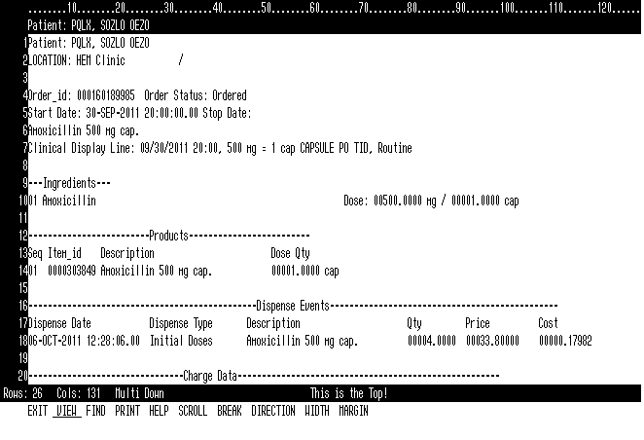
PhaMedMgr – Verify – Full Query

Slide 92
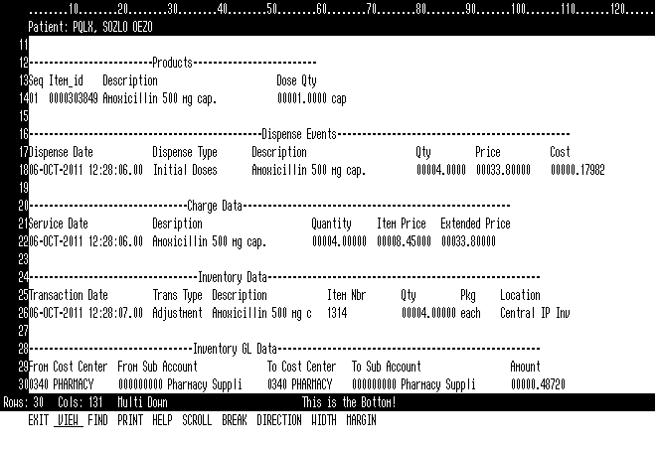
PhaMedMgr – Verify – Full Query

Slide 93
PhaMedMgr – Verify – Full Query example

